Slide 1
MUSIC STORE
SQL ANALYSIS
BY ANKITA KUMARI

Slide 2
PROBLEM STATEMENT
A music retailer aims to identify key factors for enhancing its business performance, diagnosing existing operational challenges, identifying high-value customer segments, and obtaining valuable insights for innovative marketing and initiatives.
We will be using SQL to solve these problems

Slide 3
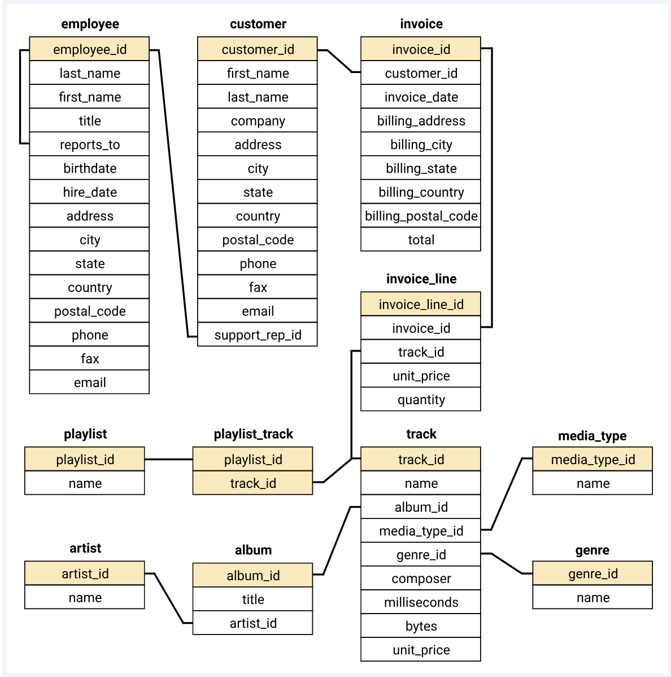
SCHEMA

Slide 4
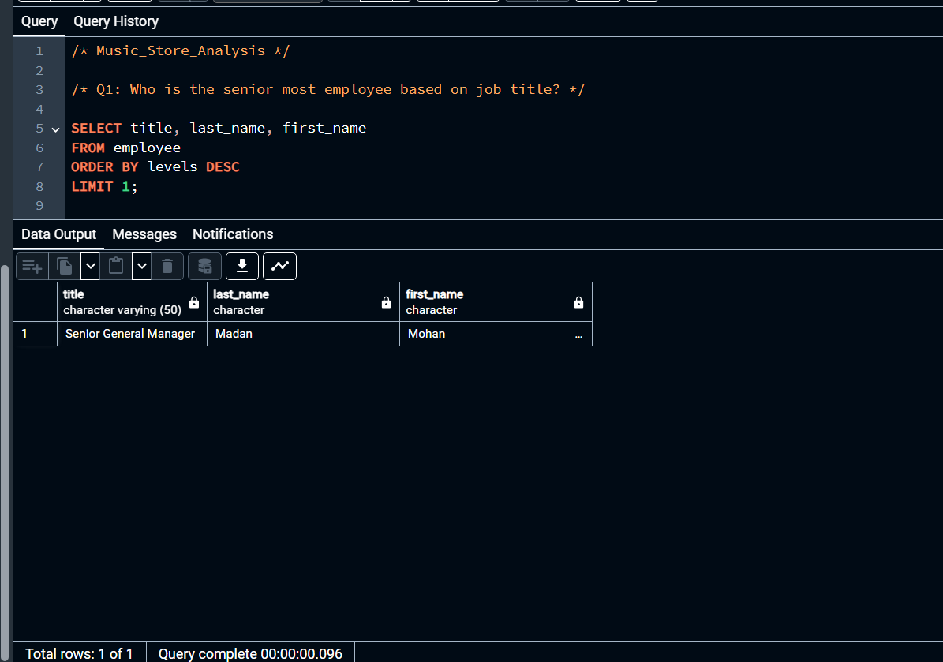

Slide 5
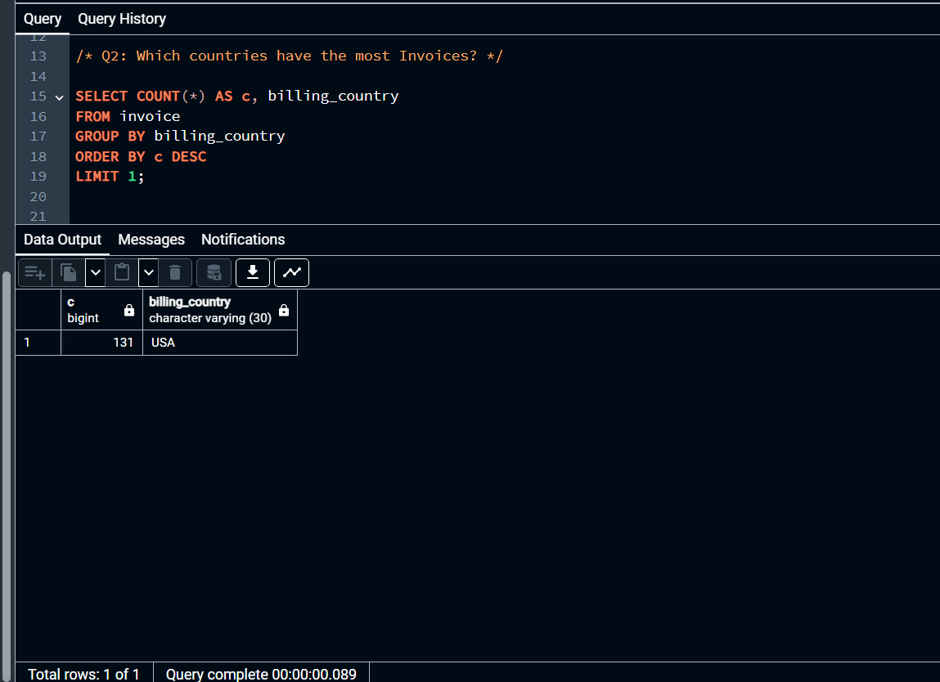

Slide 6
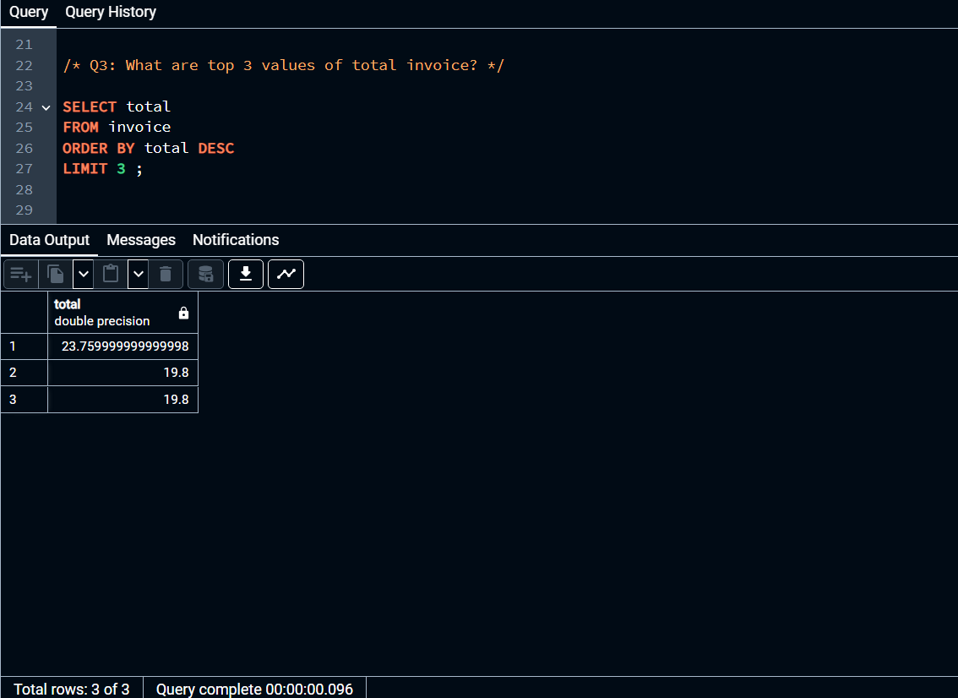

Slide 7
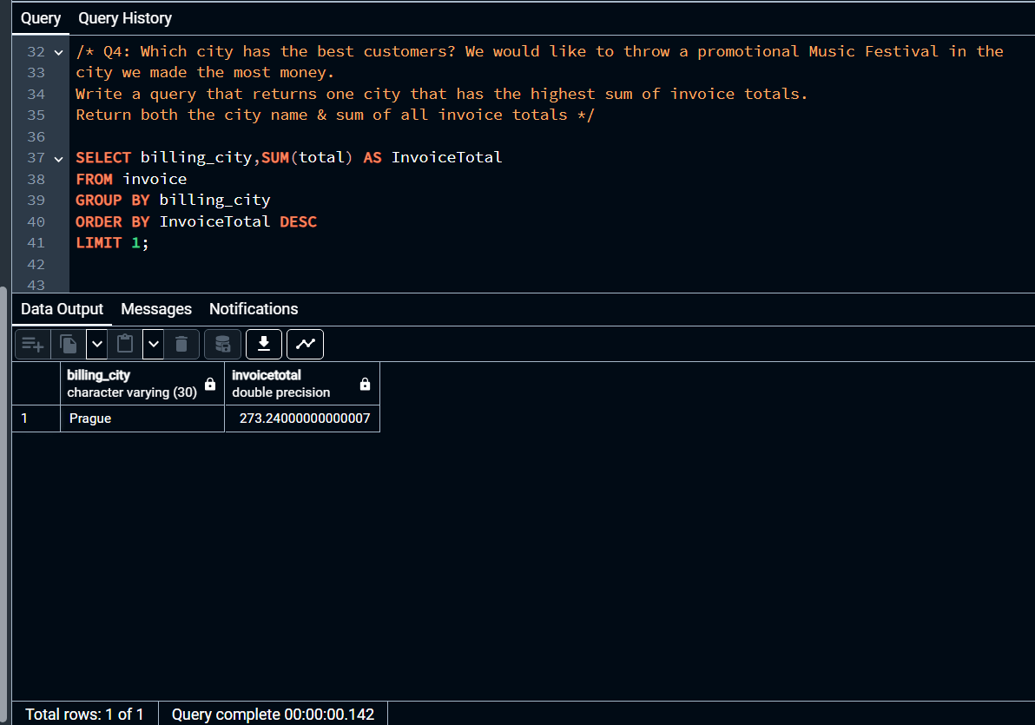

Slide 8
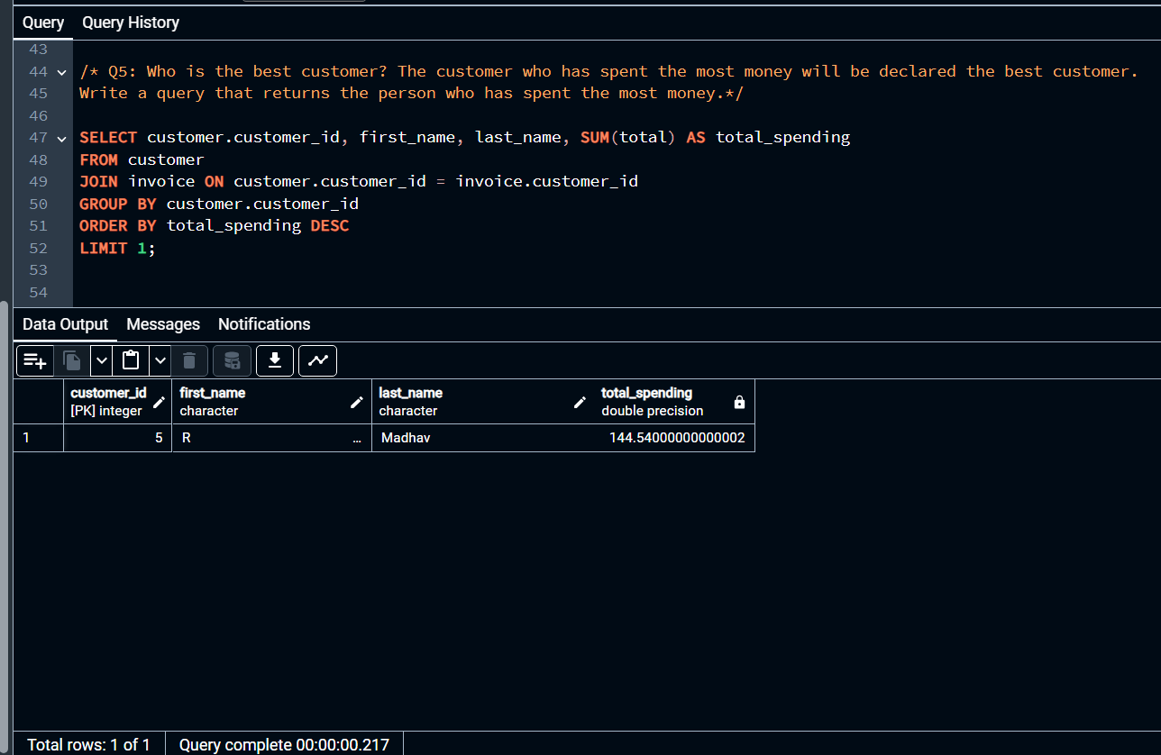

Slide 9
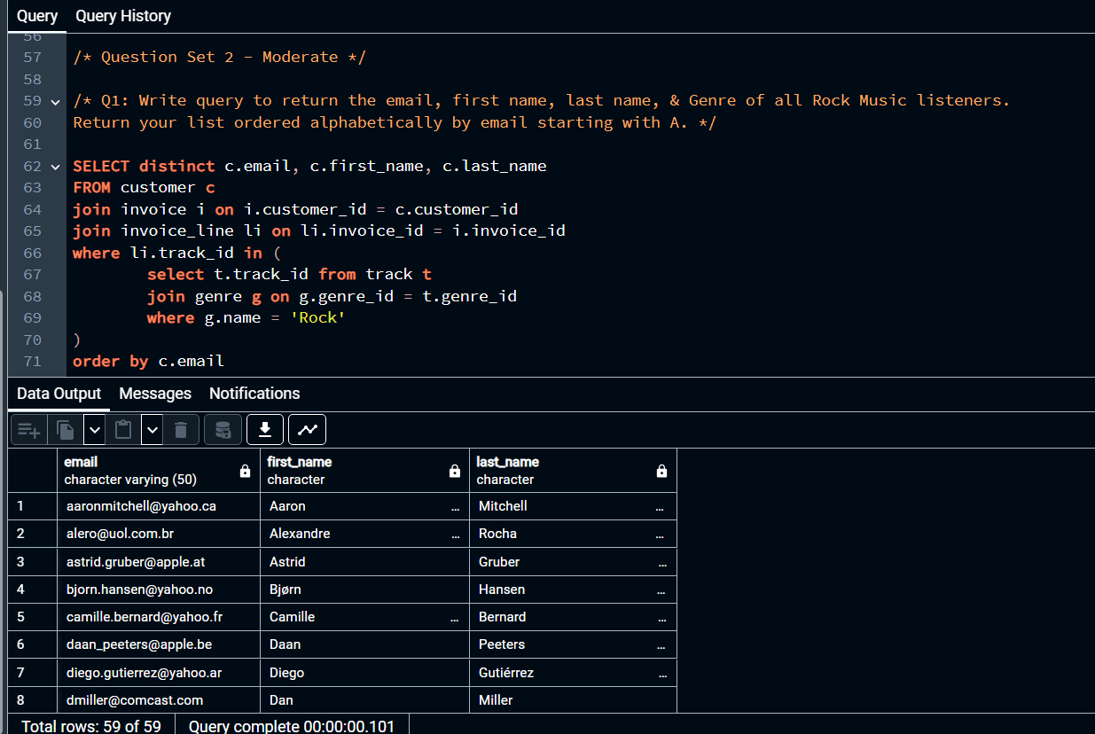

Slide 10
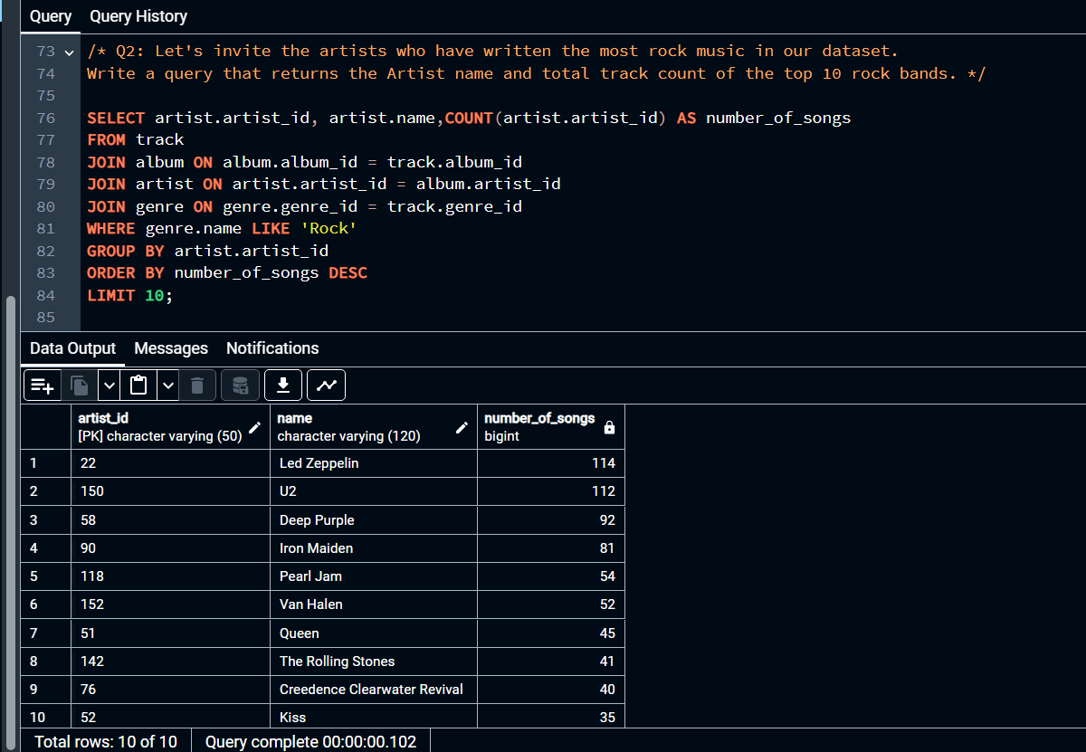

Slide 11
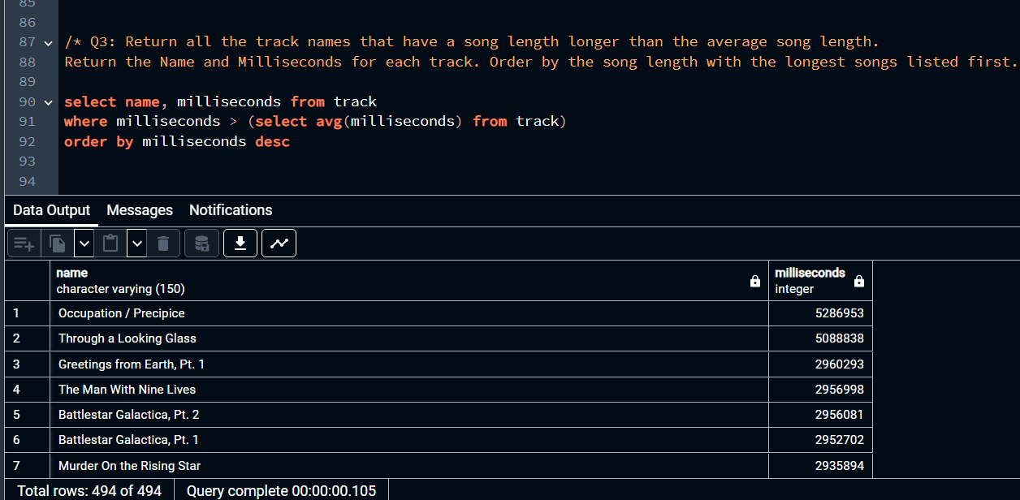

Slide 12
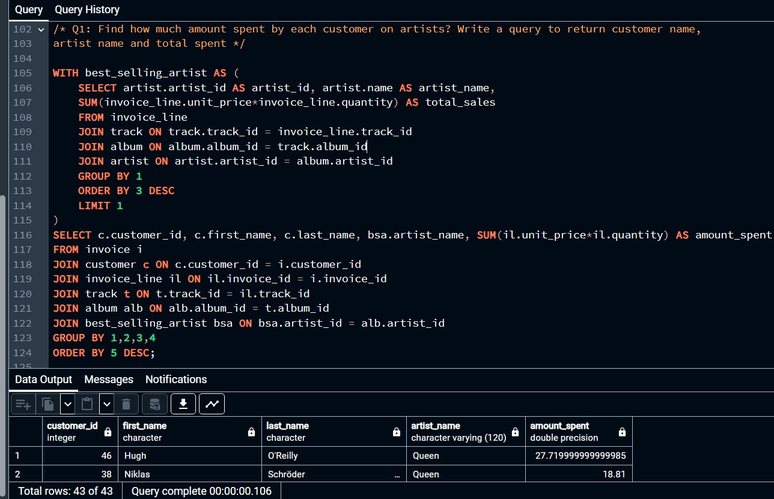

Slide 13
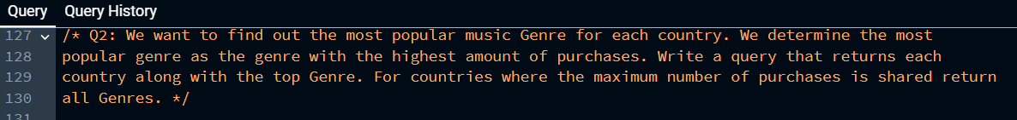
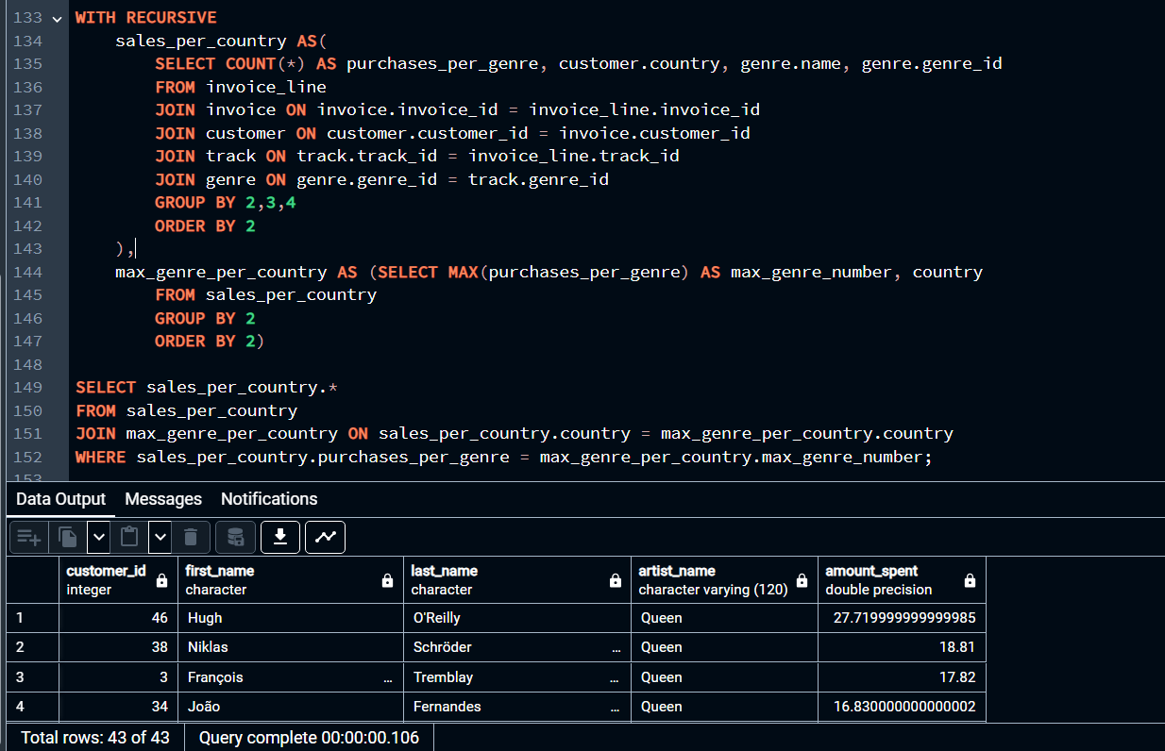

Slide 14
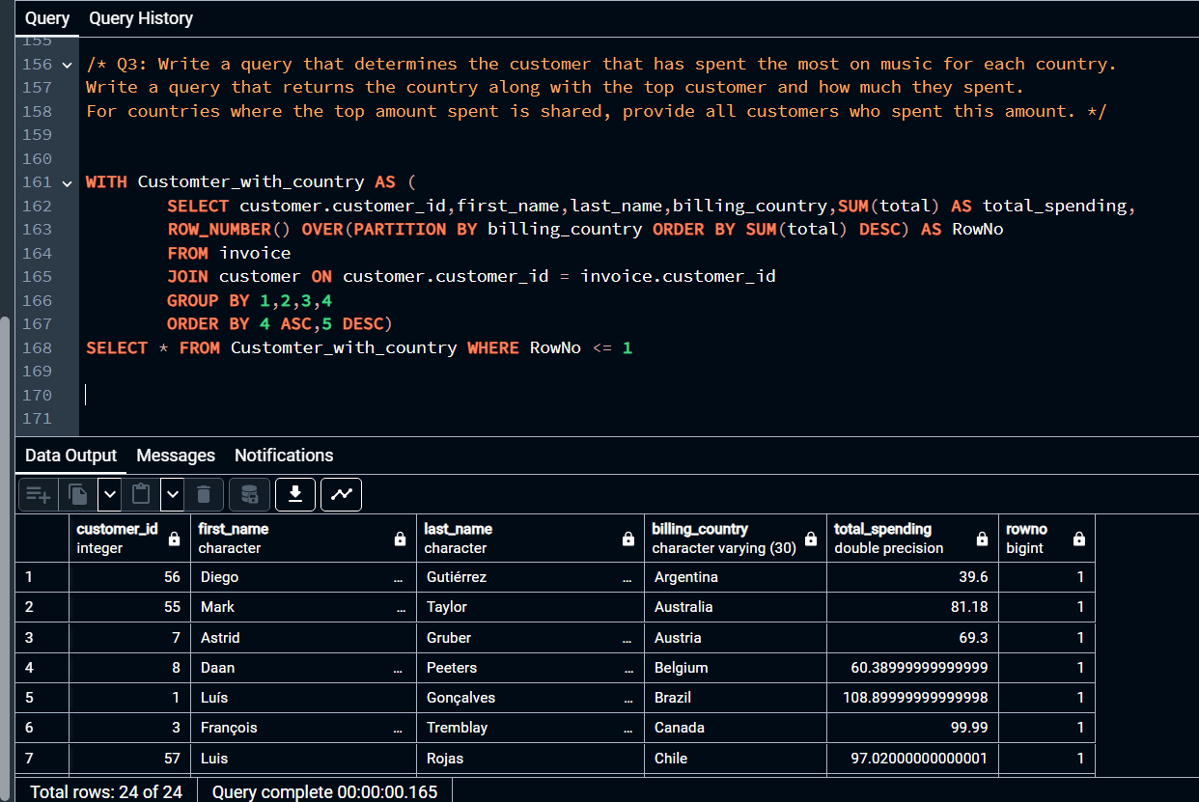

Slide 15
THANK YOU

